Slide 2
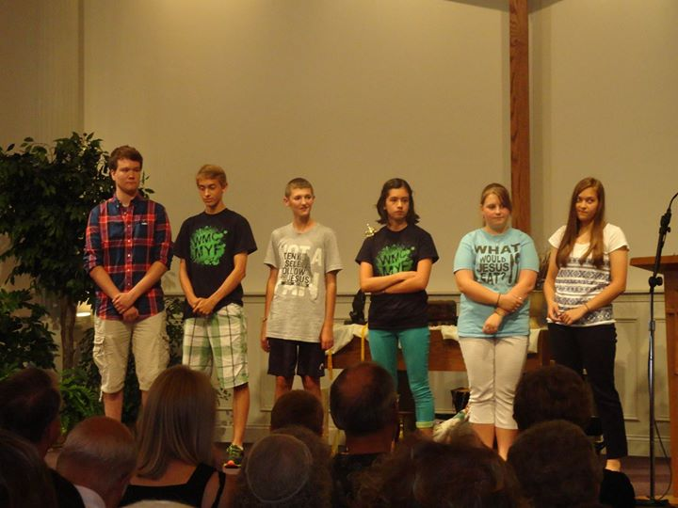

Slide 5
Ways to view the Bible
A literary collection containing a variety of different disconnected books

Slide 6
Ways to view the Bible
A literary collection containing a variety of different disconnected books
A book of laws, propositions, ideas & theology

Slide 7
Ways to view the Bible
A literary collection containing a variety of different disconnected books
A book of laws, propositions, ideas & theology
A single book of scattered, disconnected stories

Slide 8
Ways to view the Bible
A literary collection containing a variety of different disconnected books
A book of laws, propositions, ideas & theology
A single book of scattered, disconnected stories
A book of a God-scripted “puppet show” of God solving the sin problem

Slide 9
Ways to view the Bible
A dynamic story of God’s interaction with a chosen people through whom God would be revealed to the whole world, for the purpose of reconciliation

Slide 10
Historie: My car spun on the ice, hit a tree, and I walked away unharmed.
Geschichte: My car spun on the ice, hit a tree, and God saved my life.

Slide 11
Heilsgeschichte
Holy interpreted history

Slide 12
The Bible’s purpose
“These [things] are written so that you may come to believe that Jesus is the Messiah, the Son of God, and that through believing you may have life in his name.”
John 20:31 (NRSV)

Slide 14
3 Questions to ask of a Bible text:
What is the sin problem?
What is God doing to solve the sin problem?
How faithfully are God’s people cooperating?

